Slide 1
BILATERAL FILTER IN
DIGITAL IMAGES PROCESSING
Notes:
Today I’ll be presenting on FUNDAMENTALS OF SPACTIAL FILLTERING
– a fundamental technique used to enhance image quality before deeper analysis.

Slide 2



GAUSSIAN FILTER KERNEL
Original Image
Gaussian Kernel 25x25 sigma = 2.0
Gaussian Kernel 25x25 sigma = 5.0
Notes:
To reduce image noise, we often blur the image. One of the most common tools is the Gaussian kernel. In the example below, we can clearly see the effect of the Gaussian kernel in blurring and removing noise.
However, when we increase sigma — in order to enhance the blurring effect — the Gaussian filter also blurs the edges. This causes the image to lose important details. We can clearly see this in Image 3, where the edges are no longer sharp.
To overcome this drawback of Gaussian Blur, a more intelligent filter called the Bilateral Filter is used.

Slide 3
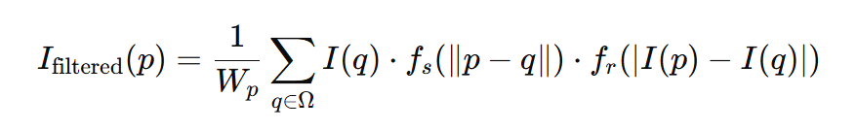
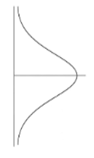
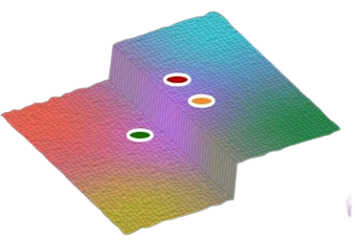
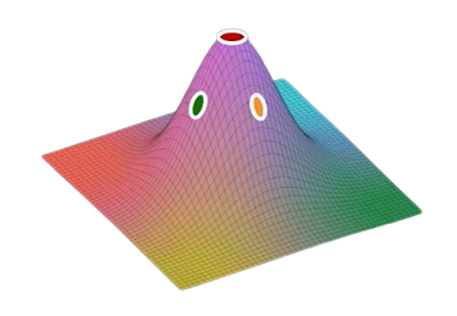
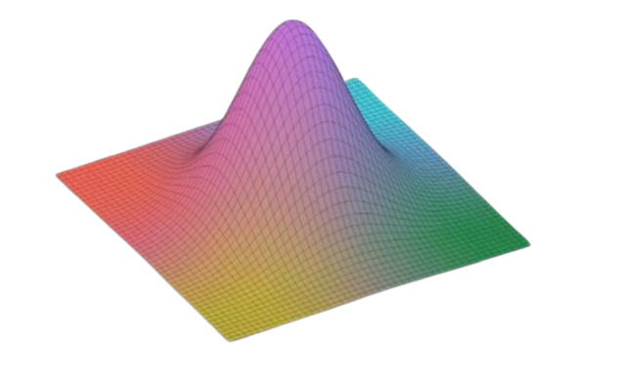
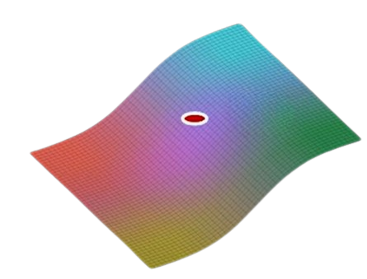
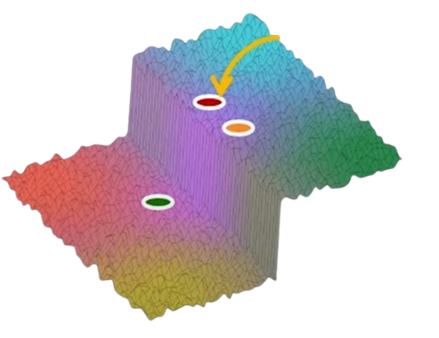
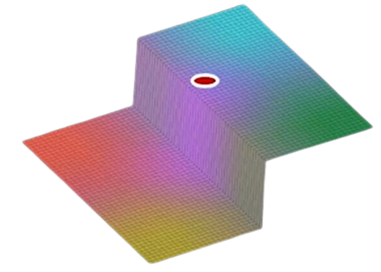
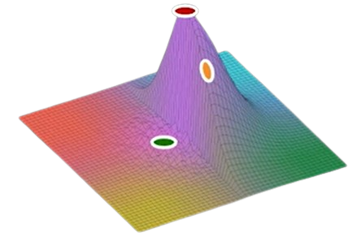
Bilateral Filter and Gaussian Filter
Spatial Gaussian
Brightness Gaussian
Intensity
weight
p
Multiply
Output
Input
Notes:
The expression shown here is just the convolution of an image with a spatial Gaussian; it is just Gaussian smoothing. Consider the section of the input image in the right corner It is a step edge that is corrupted by noise. We would like to remove the noise while preserving the edge. When the Gaussian filter is applied to the image patch with its center at the image pixel P, Lets Consider two points: one yellow and one green. The yellow point receives a high weight — because it is close to the center. That makes sense since it lies on the same side of the edge.
However, the green point you see here is also assigned a similar weight, even though it lies on the other side of the edge. This doesn’t make sense — and that’s exactly the problem we want to solve.
The effect of applying a Gaussian that is independent of the content around the pixel is that, while noise is reduced, the output image is blurred. On the left we see the output where the edge in the original image is washed out.

Slide 4
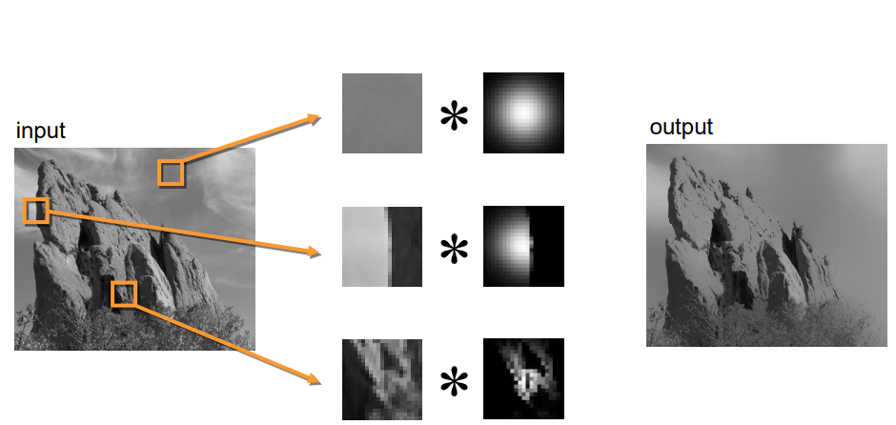
Bilateral Filter
Input
Bilateral Filter
Notes:
This example demonstrates how the shape of the kernel depends on the image content. The first row shows a constant area; the second row shows a step edge, as we discussed in the previous section; and the third row shows an input with an arbitrary shape.

Slide 5
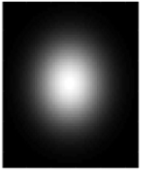
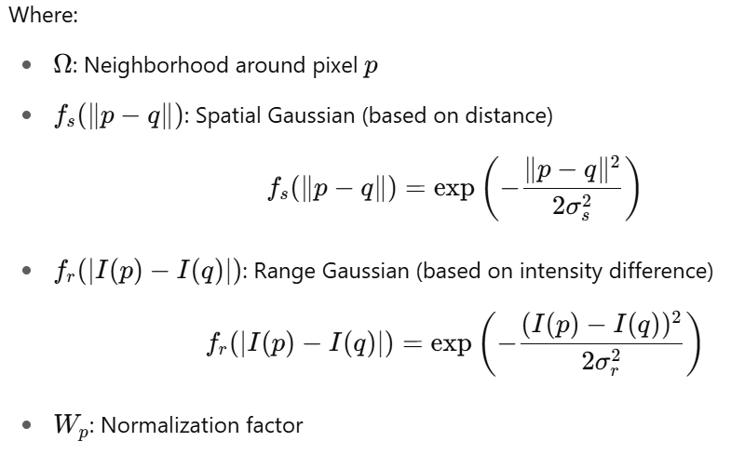
Mathematical Formula of Bilateral Filter
Spatial Gaussian
Brightness Gaussian
Intensity
weight

Slide 6
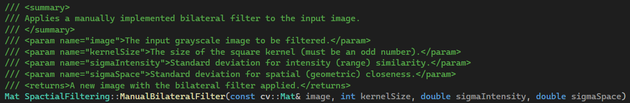
Program

Slide 7
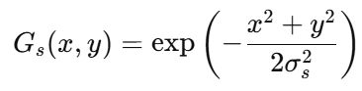
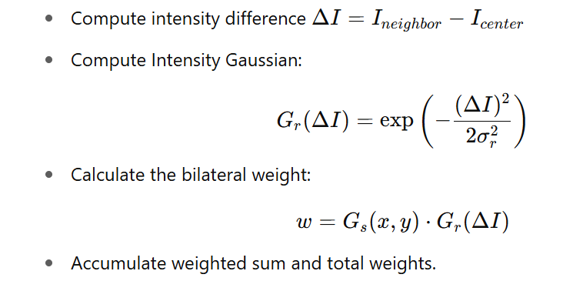
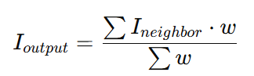
Program
Step 1: Initialization and padding the image
Step 2: Precompute Spatial Gaussian Kernel
Each weight depends on pixel's distance from center of the kernel.
This is fixed for all pixels, so computed once.
Step 3: Loop over every pixel in the image
For each pixel in the kernel window
Step 4: Normalize the result:
Step 5: Return the result image

Slide 8
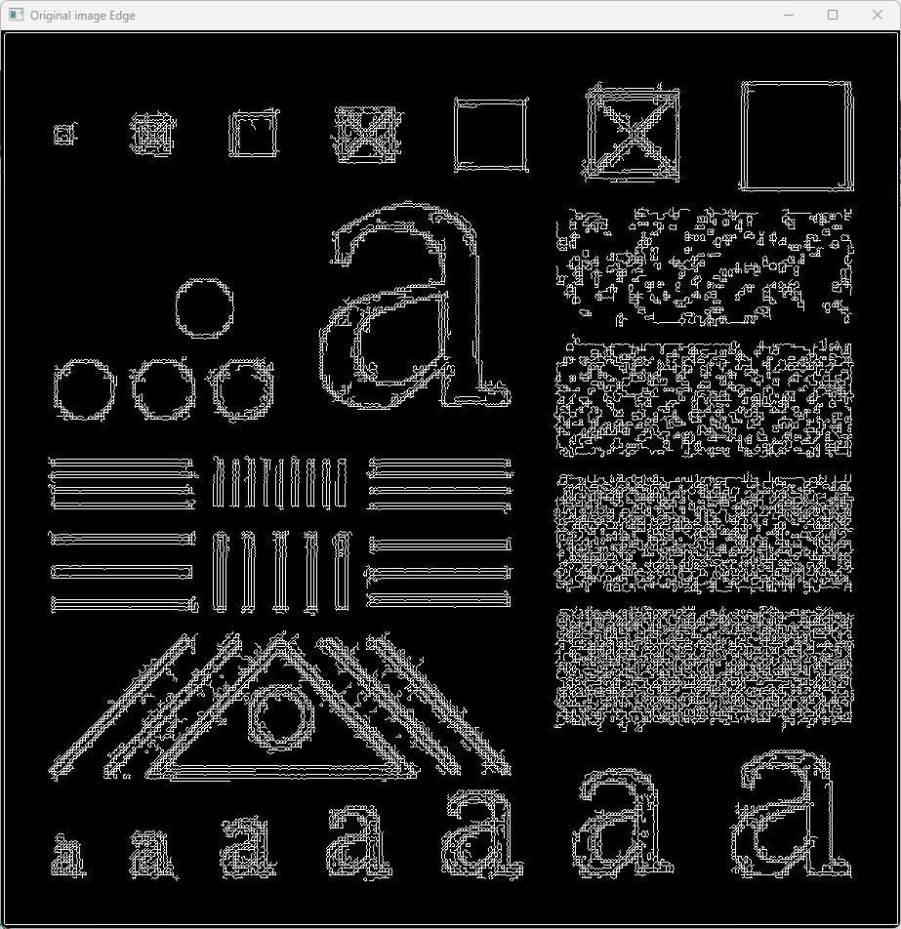
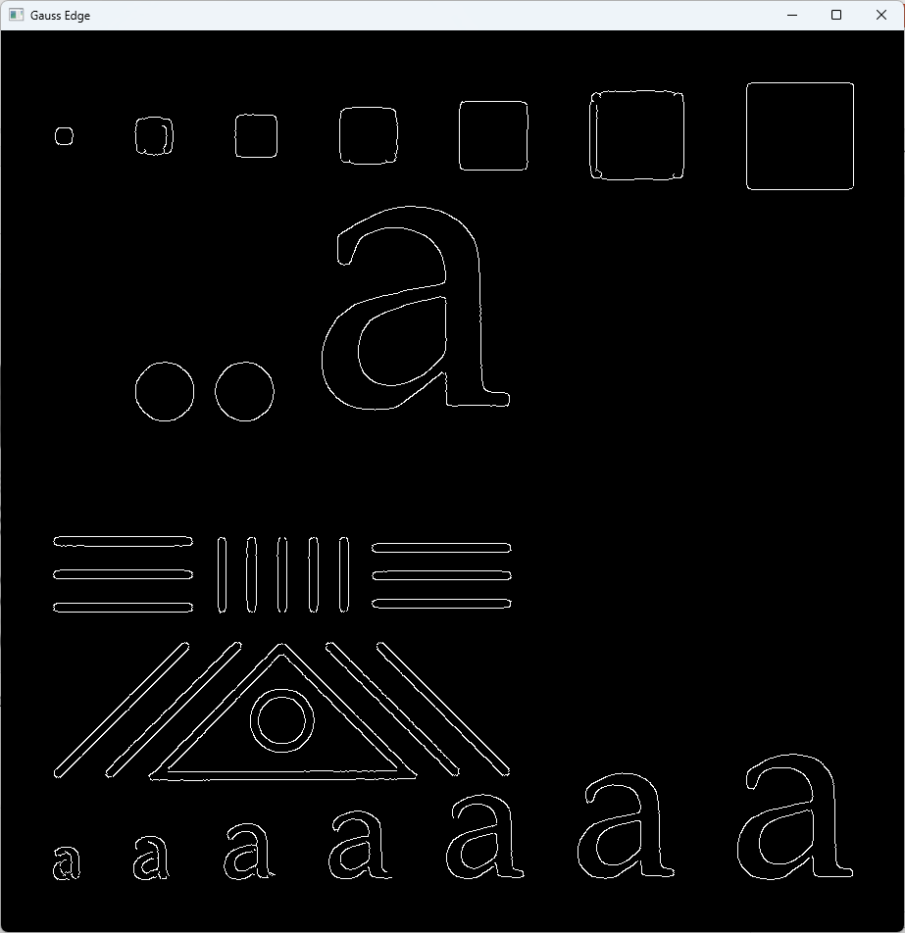
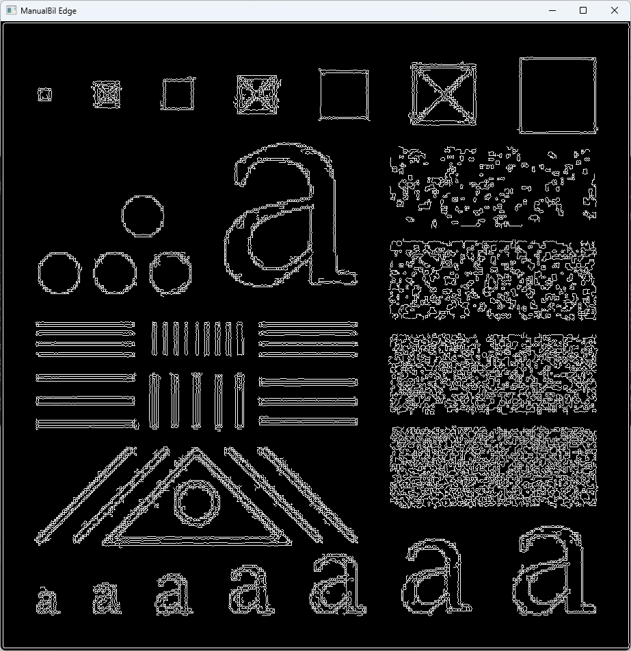



Result
Original image
Gaussian filter 25x25 = 3.0
Bilateral filter 25x25 = 3.0, = 10.0

Slide 9
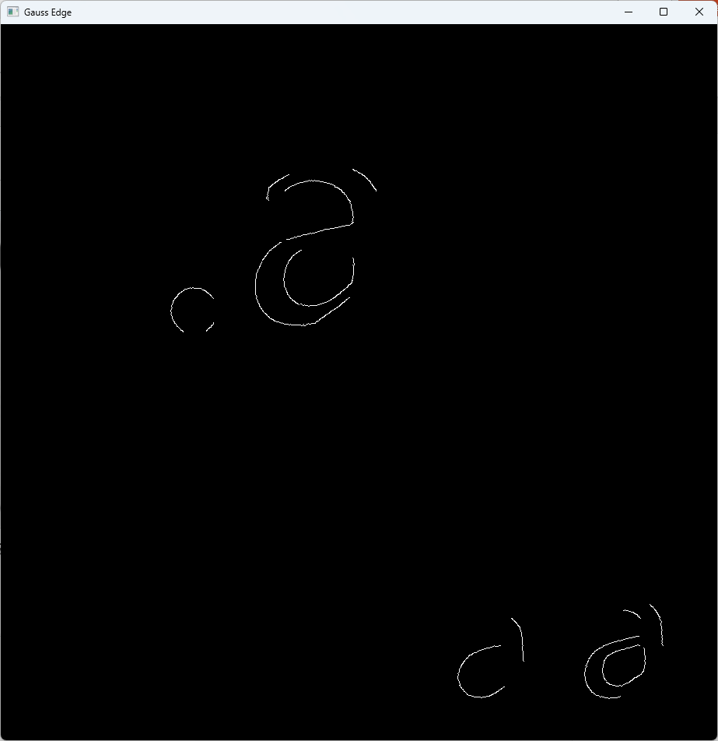


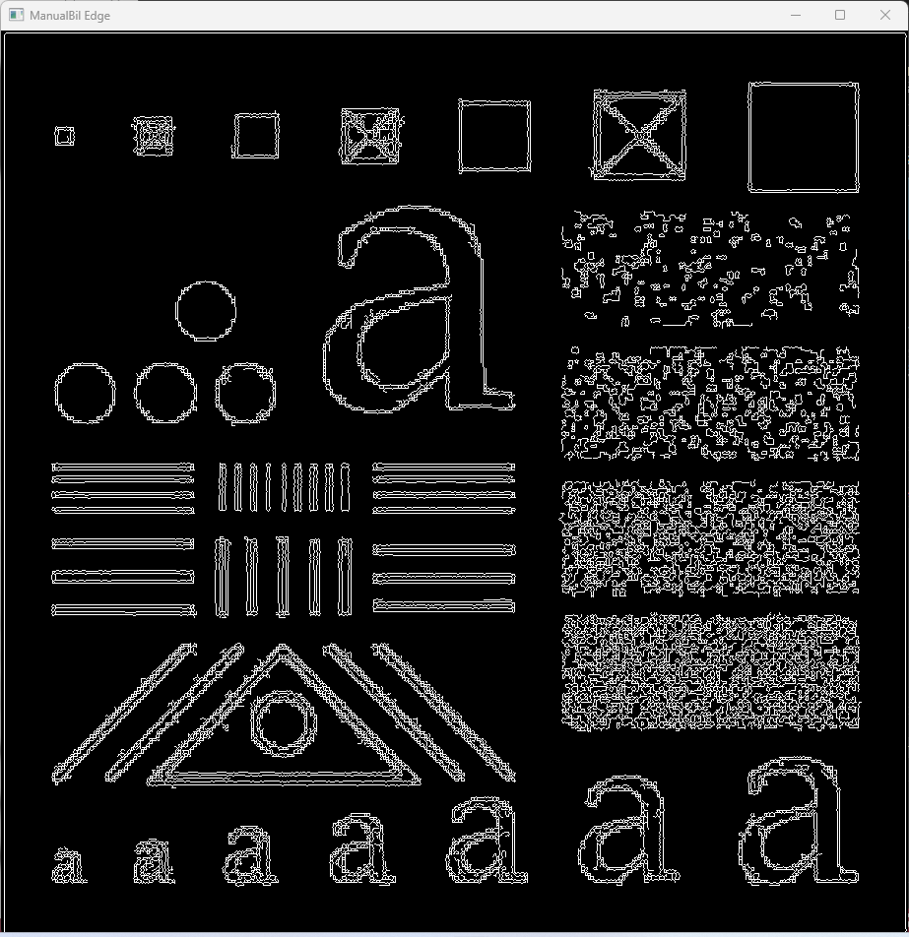
Result
Original image
Gaussian filter 25x25 = 5.0
Bilateral filter 25x25 = 5.0, = 10.0

Slide 10


Result
Original image
Bilateral filter 25x25 = 5.0, = 10.0
Bilateral filter 25x25 = 15.0, = 10.0

Slide 11

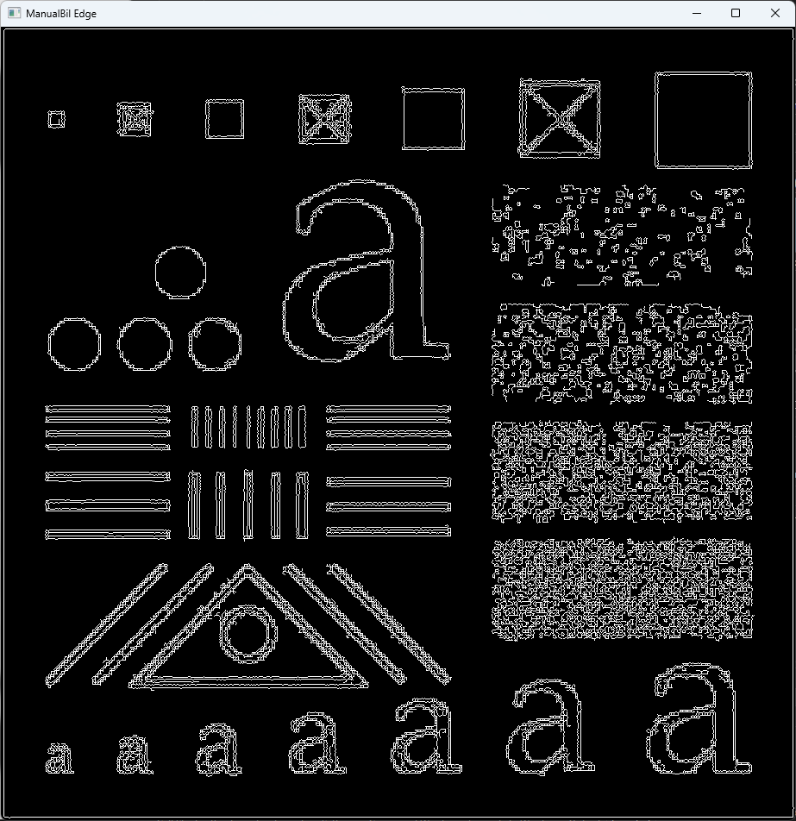

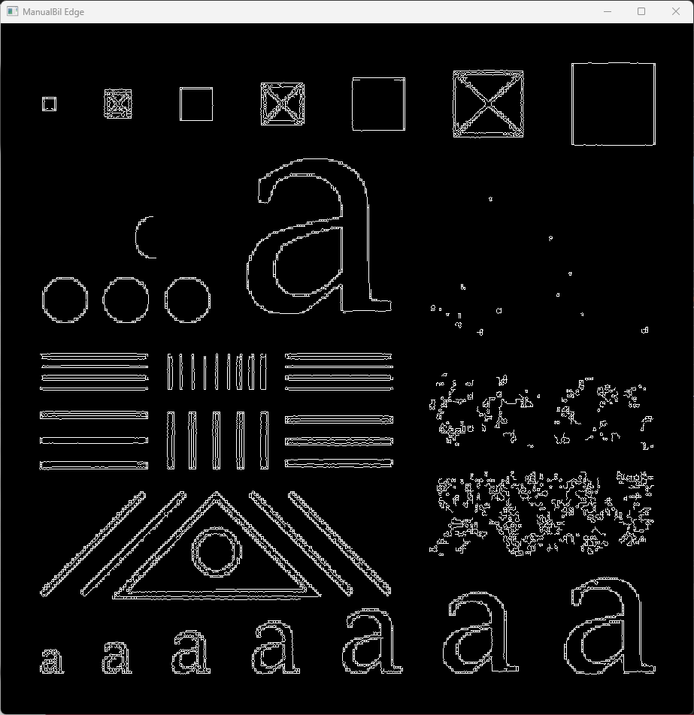
Result
Original image
Bilateral filter 25x25 = 15.0, = 10.0
Bilateral filter 25x25 = 15.0, = 40.0

